Slide 1
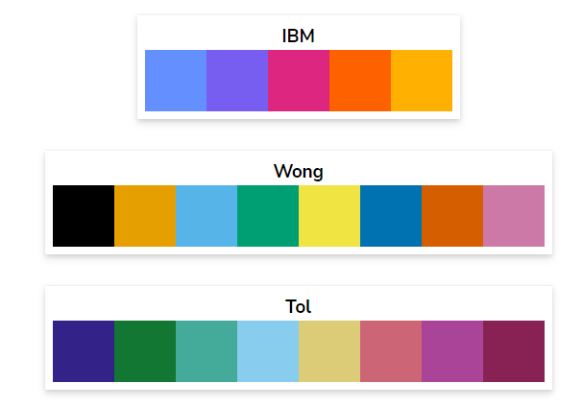
Internal Plumbing and Components Explained
Valve (Generic): Controls flow by either opening or closing off a fluid connection in a pipe
Check Valve: Only allows fluid flow in one direction
Stop-Check Valve: Can open or close, but only allows flow in one direction while open
Filter or Strainer: filters contaminants from fluid

Slide 2
Sealed Piston
Assembly
Wash Chamber
Clothing Item
Fluid Occupying Wash Chamber
Suction/Outlet to Reservoir

Slide 3
Piston Shaft
Inlet/Outlet to Reservoir
Chamber Top Piston
Reservoir
Compression Piston
Wash Chamber Clothing Compartment
Inlet/Outlet to Wash Chamber
Clothing Access Hatch

Slide 4
Basic Wash Cycle: Hydration Phase

Slide 5
Basic Wash Cycle

